Slide 1




TYPES OF
COMPREHENSION

Slide 2

Literal
TYPES OF READING
Inferential
Applied
Evaluative
COMPREHENSION
Lexical

Slide 3




LITERAL
the five Ws (who, what, where, when, and why)
facts and information that are directly stated
locate the answer: the main idea, supporting details, sequencing events, and answering recall questions

Slide 4

SKILLS USED FOR LITERAL QUESTIONS
identifying keywords
scanning techniques
utilizing skimming

Slide 5



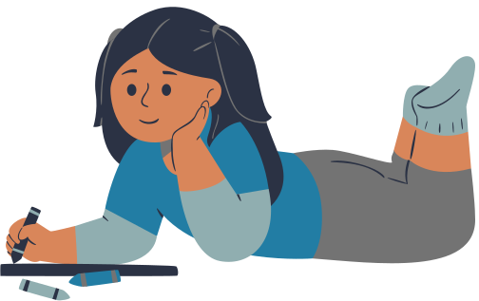
INFERENTIAL
predicting the unfolding of events
inferring meaning from context
asks the reader to read “between the lines”

Slide 6
SKILLS USED FOR INFERENTIAL QUESTIONS
make logical connections
interpret figurative language
draw conclusions

Slide 7


APPLIED
using background knowledge to form an opinion about a text and retell it to others
figuring out the ultimate message of a text
purpose of the text

Slide 8
SKILLS USED FOR APPLIED QUESTIONS
analytical thought
uncovering bias and motive
deduce the importance of a text

Slide 9

EVALUATIVE
judge the text based on the author’s tone, language, and writing style; to read between the lines
asks the reader to decide whether he or she agrees with the author's ideas or point of view in light of his or her own knowledge, values, and experience

Slide 10
SKILLS USED FOR EVALUATIVE QUESTIONS
critical thinking
extensive knowledge
reasoning

Slide 11




LEXICAL
Infer the meaning of target vocabulary items within texts
LOOK UP THE KEYWORDS AND PHRASES BEFORE READING A TEXT

Slide 12
SKILLS USED FOR LEXICAL QUESTIONS
synonyms/antonyms
parts of speech
figurative language

Slide 13
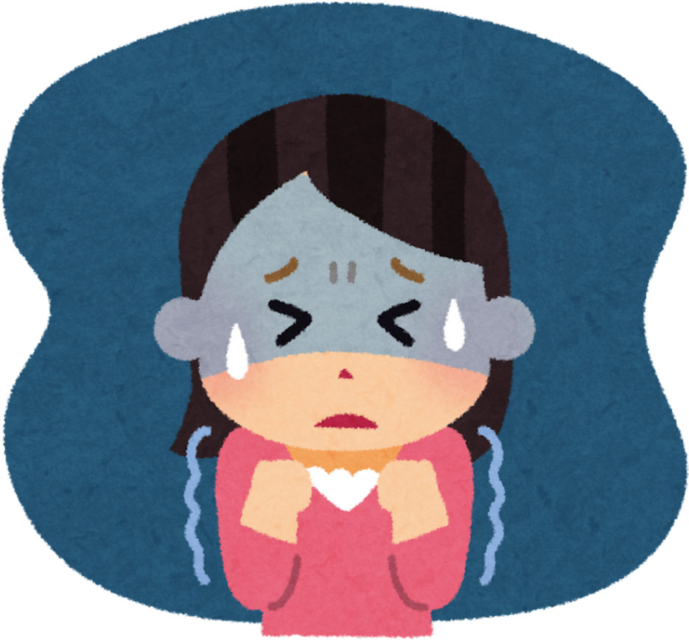
PHOBIAS
What is a phobia?
A phobia is an intense fear or feeling of anxiety that occurs only in a particular situation that frightens you. This might be something as seemingly logical as a fear of heights, or as illogical as a fear of the colour green. At other times you don’t feel anxious. For example, if you have a phobia of spiders (as millions of people do), you only feel anxious when there’s a spider around, otherwise you feel fine. About one in ten people has a significant phobia, although few people seek treatment. People develop phobias to all sorts of things. Each phobia has its own name.

Slide 14

The purpose of the text is to ...
A) give information about phobias
B) give instructions for people with phobias
C) persuade people with phobias to seek help
A phobia ...
A) happens to everyone when they are frightened
B) happens only in certain situations
C) only happens to people who are anxious

Slide 15

The purpose of the text is to ...
A) give information about phobias
B) give instructions for people with phobias
C) persuade people with phobias to seek help
A phobia ...
A) happens to everyone when they are frightened
B) happens only in certain situations
C) only happens to people who are anxious

Slide 16
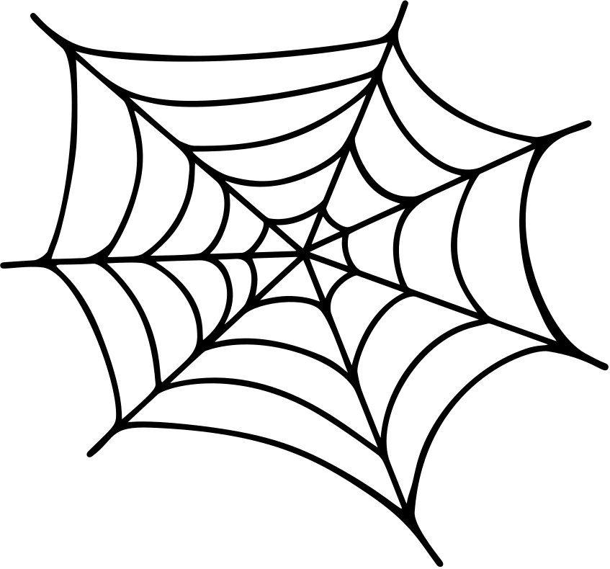
Phobias ...
A) are logical
B) are not logical
C) can be logical or not logical
The number of people who have phobias is ...
A) five out of ten people
B) ten people
C) 10 percent of the population

Slide 17

Phobias ...
A) are logical
B) are not logical
C) can be logical or not logical
The number of people who have phobias is ...
A) five out of ten people
B) ten people
C) 10 percent of the population

Slide 18
Phobias make people avoid situations they know will make them anxious, but this can make the phobia worse. A person’s life can become increasingly dominated by the precautions they take to avoid a situation they fear. You may know there’s no real danger and you may feel embarrassed by your fear, but you’re still unable to control it. It’s better to confront your fears, even if it’s in a very careful way or with the help of a trained therapist. A phobia is more likely to go away if it began after a distressing or traumatic event.

Slide 19
The writer advises people with phobias to ...
A) consult a psychotherapist
B) avoid situations that make them anxious
C) confront the fear rather than avoid it
What is the main message of this article?
A) Some people have phobias and live in fear of certain things.
B) If you have a phobia you should see a therapist.
C) What a phobia is and how to treat it.

Slide 20

The writer advises people with phobias to ...
A) consult a psychotherapist
B) avoid situations that make them anxious
C) confront the fear rather than avoid it
What is the main message of this article?
A) Some people have phobias and live in fear of certain things.
B) If you have a phobia you should see a therapist.
C) What a phobia is and how to treat it.

Slide 21
What is the antonym of the word “embarrassed” in the text?
A) awkward
B) confident
C) shy
Find the correct synonym for the word “distressing” in the text?
A) calm
B) comfortable
C) upset

Slide 22
What is the antonym of the word “embarrassed” in the text?
A) awkward
B) confident
C) shy
Find the correct synonym for the word “distressing” in the text?
A) calm
B) comfortable
C) upset

Slide 23


